Slide 1
Training deep NCRF on noisy labels
--Longxu Dou

Slide 2
Outline
Task Definition
Traditional CRF
Neural CRF
Semi-Supervised NCRF
My work

Slide 3
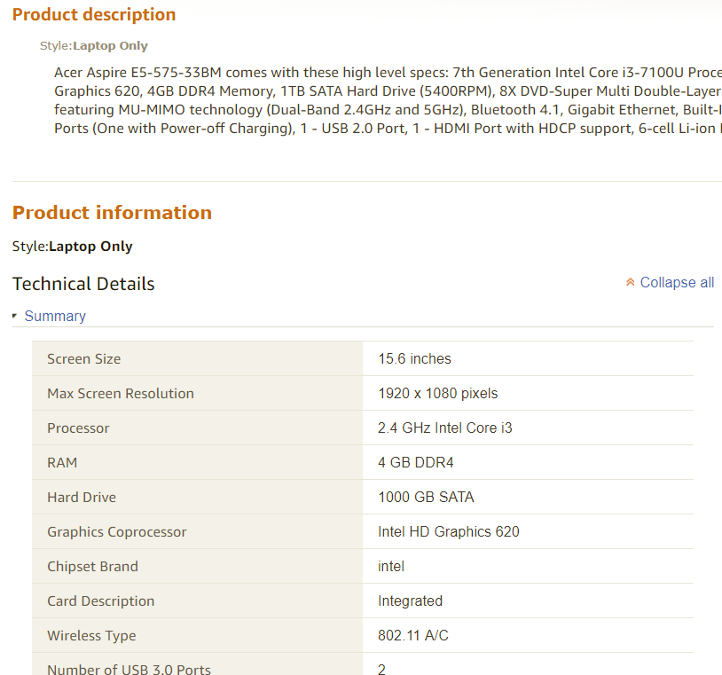
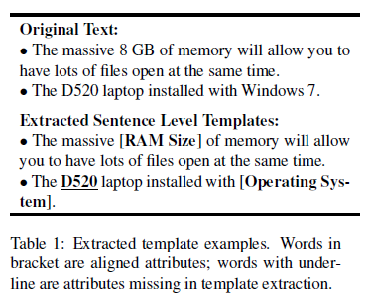
Extract Template
Notes:
已有的平行文本来自于亚马逊网站，通过一些简单的规则在短语级别进行了对齐。这对齐的质量还不高，需要用NCRF来提高模板的对其效果。

Slide 4
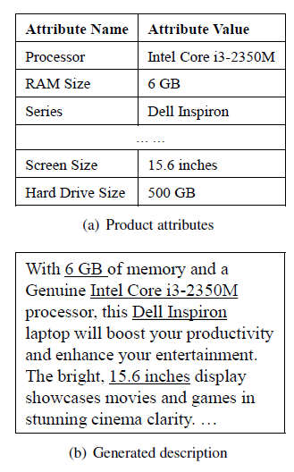
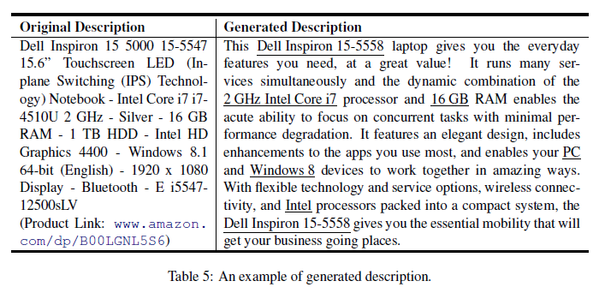
Generate Description
Notes:
抽取的模板之后用于文本生成。可以是通过已有的表格生成，也可以修正目前质量不高的平行文本

Slide 5
Task Formalism
Goal: Improve generalization performance using unlabeled/derived labeled data.
Different dataset sources
Manual labeled : rare, expensive, accurate
Derived labeled : semi-constructed, partial label/incorrect label
Unlabeled : raw text, rich in website
Error types | Pairs
Correct | new Intel core i7 processor (O B-Processor I-Processor I-Processor O)
Missing | new Intel core i7 processor (O O O O O)
Mistake | new Intel core i7 processor (O B-memory I-memory I-memory O)
Length error (Frequent in real task) | new Intel core i7 processor (O B-Processor I-Processor O O)
Notes:
总的目标是提高模板的抽取质量，
已有的训练集有三种：人工标注的全标注数据，规则对齐生成的半标注数据，网上存在的无标注平行文本数据
半标注数据集中存在以下几种标注情况，正确标注，漏标，错标，标注长度不够。
这说明了半标注的训练集是有很大噪音存在的。

Slide 6
Outline
Task Definition
Traditional CRF
Neural CRF
Semi-Supervised NCRF
My work

Slide 7
Development path
Early Methods
Machine Learning Methods
Deep Learning Methods
Recently
Dictionary-based
Rule-based
HMM
MEMM
CRF
NN/CNN-CRF
RNN-CRF
Attention-based
Transfer learning
Semi-supervised
Notes:
传统的解决序列标注问题的手段是隐马尔科夫，最大熵马尔科夫模型、CRF等模型，尤其是CRF，基本是最主流的方法。
目前将神经网络与CRF模型相结合的NN/CNN/RNN-CRF模型成为了目前NER的主流模型。由于RNN有天然的序列结构，所以RNN-CRF使用更为广泛。
对于少量标注训练集问题，迁移学习，半监督学习也开始收到了关注

Slide 8


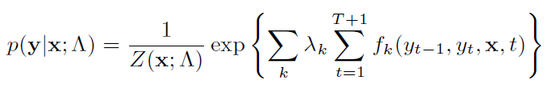

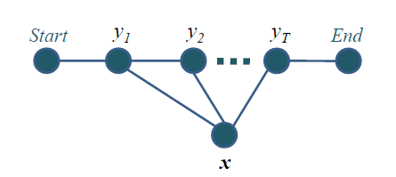
Tradition CRF
Transition feature
Unigram feature
Bigram feature
Regular feature
Lexicon feature
Begin
O B-Processor I-Processor I-Processor O
new Intel core i7 processor
End
Notes:
这里给出的是线性链CRF模型, 这是一种满足马尔科夫性的CRF，即当前预测的label只与前一个label有关。
我们定义X为输入的句子，包含T个token，y_{i}是第i个token对应的label。为了增强标签转移概率的表现，我们在头和尾加入START和END两个特别的label。
它的目标函数不仅考虑输入的状态特征函数，而且还包含了标签转移特征函数。
在训练阶段，CRF的参数需要最大化gold label的对数似然函数，参数是lamda，也就是每种特征函数所占的权重。
Partition function Z得到方式为 marginalize 所有可能的输出序列，用前向后向算法实现计算，他可以标准化指数形式为一个概率分布。
常有的特征函数在右边//在inference的时候，用维特比算法算出最大概率label的序列

Slide 9
Outline
Task Definition
Traditional CRF
Neural CRF
Semi-Supervised NCRF

Slide 10
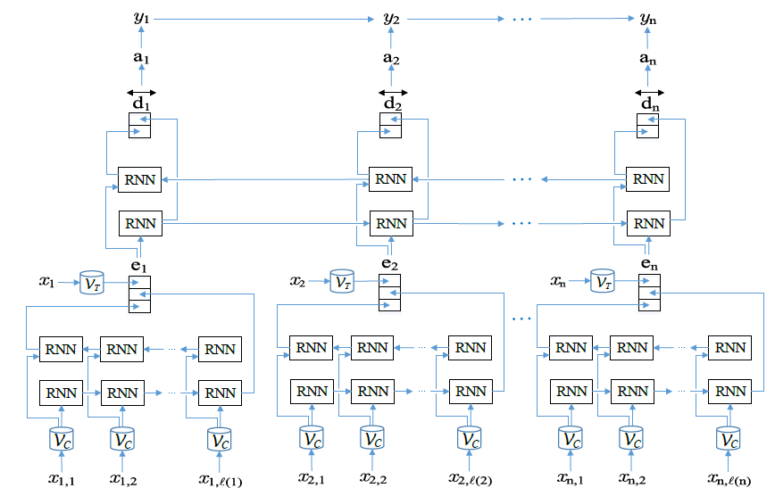
Neural CRF
Character-enhanced token embedding layer
Label prediction layer
Label sequence optimization layer
Notes:
它主要有Embedding层（主要有词向量，字符向量以及一些额外特征），双向RNN层，tanh隐层以及最后的CRF层构成。
实验结果表明RNN-CRF获得了更好的效果，已经达到或者超过了基于丰富特征的CRF模型，成为目前基于深度学习的NER方法中的最主流模型。
在特征方面，该模型继承了深度学习方法的优势，无需特征工程，使用词向量以及字符向量就可以达到很好的效果，如果有高质量的词典特征，能够进一步获得提高。

Slide 11
Outline
Task Definition
Traditional CRF
Neural CRF
Semi-Supervised NCRF
My work

Slide 12
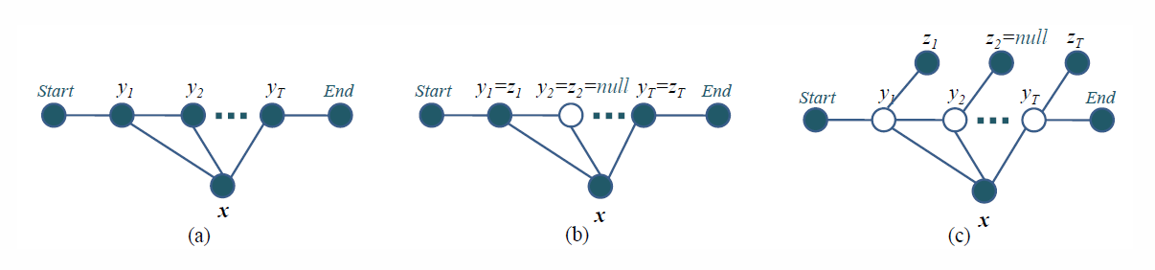


Semi-Supervised CRF (Xiao Li, SIGIR2009)
manual labeled: initialize the model by supervised learning, testing
derived labeled: hard evidence (treated same as the manual label)
derived labeled: soft evidence (view the entire state as hidden variables)
Notes:
而对于深度学习方法，一般需要大量标注数据，但是一些任务并没有足够多的标注数据。所以在基于神经网络结构方法中如何使用少量标注数据进行序列标注也是最近研究的重点。其中包括了半监督学习。
拿这三张图的举例的话，第一张图就是很传统的全监督训练的CRF，这种模型在我们这种标注质量不高的数据集上学习，效果会越来越差，因为他会学习到大量的噪音。
而第二张图则是将missing label也就是未无label的字符看作隐藏状态，通过后验概率计算其label的分布，然后通过EM求解优化，作者在文章中将第二张图称之为hard EM，因为把噪音label 也看做了正确label，还是会学习到很多噪音
最后一张图更进一步，将所有的真实label看作hidden label。训练的过程去学习隐藏的真实label到可观察到的噪音label的判别概率。
训练方法同样是用EM优化 边际似然函数的下界。这项工作需要小部分全标注数据用作EM初始化，然后用半标注的数据进行后面的训练。

Slide 13
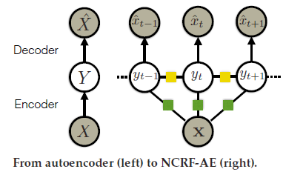
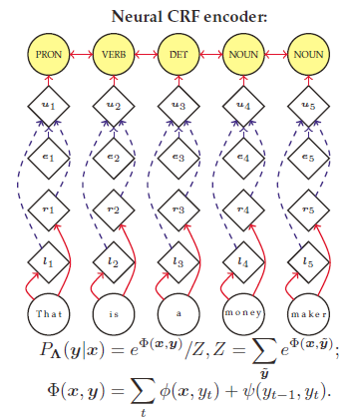


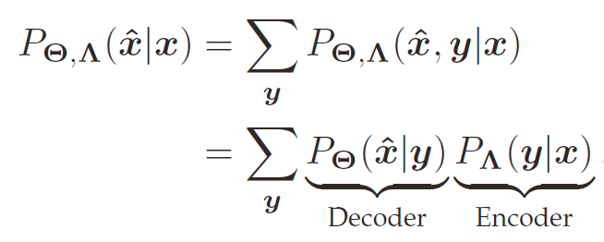

Semi-Supervised NCRF (EMNLP 2017)
Decoder:
Notes:
17EMNLP有一项工作就是基于这样的一种假设，提出了NCRF-Autoencoder模型。模型的encoder部分是NCRF，是一个从x到y的判别模型，而decoder部分是一个生成模型则，学习从y到x_{hat}的reconstruction probability。
它首先用全部的全标注数据初始化decoder部分，然后再结合无标注数据，优化encoder部分，然后再更新decoder部分。
一句话来讲，就是利用不断y->x_{hat}的先验知识去增强CRF层中x->y的这条边的可信度。

Slide 14


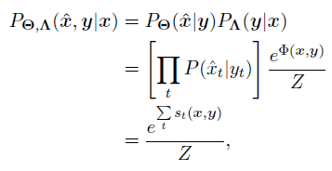
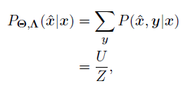


Unified learning framework
Function | Labeled Data | Unlabeled Data
Loss Function
Likelihood
Score function

Slide 15
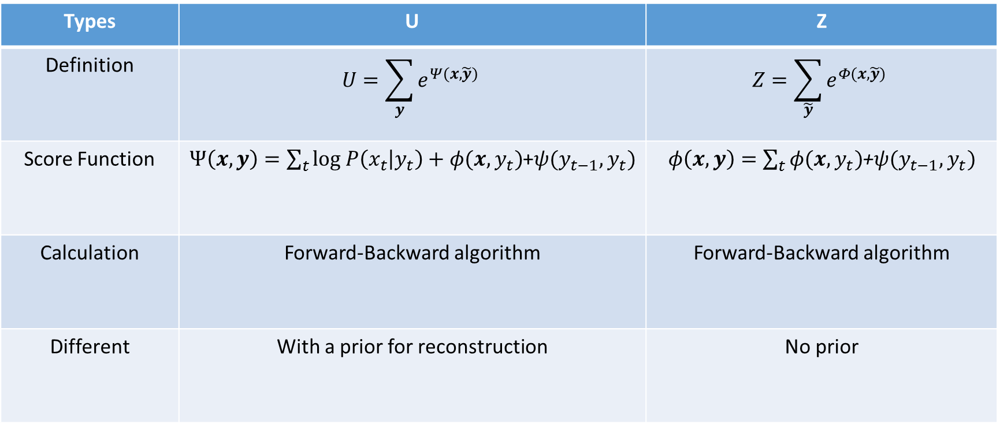
Compare U and Z
Types | U | Z
Definition | $$U=\sum_{y}{e^{Ψ(x,\tilde{y})}}$$ | $$Z=\sum_{\tilde{y}}{e^{Φ(x,\tilde{y})}}$$
Score Function | $Ψ\left(x,y\right)=\sum_{t}{log P\left(x_{t} | y_{t}\right)+φ(x,y_{t})}$+$ψ(y_{t−1},y_{t})$ | $φ\left(x,y\right)=\sum_{t}{φ(x,y_{t})}$+$ψ(y_{t−1},y_{t})$
Calculation | Forward-Backward algorithm | Forward-Backward algorithm
Different | With a prior for reconstruction | No prior

Slide 16
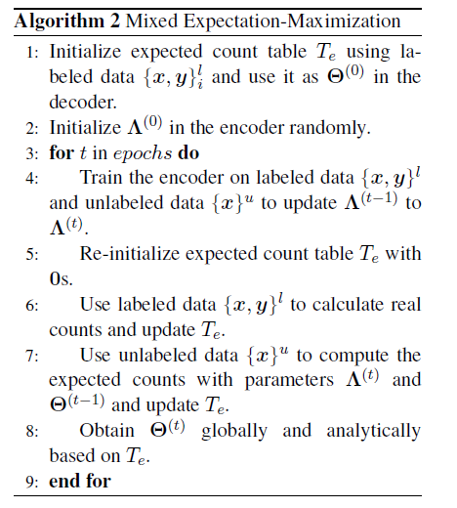
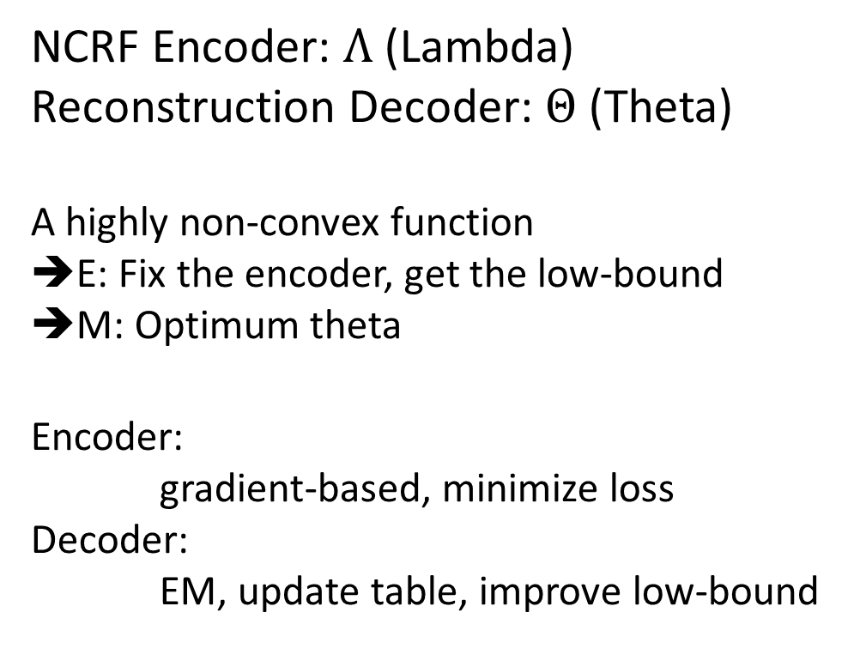
Mixed EM algorithm
NCRF Encoder: $Λ$ (Lambda)
Reconstruction Decoder: $Θ$(Theta)
A highly non-convex function
➔E: Fix the encoder, get the low-bound
➔M: Optimum theta
Encoder:
gradient-based, minimize loss
Decoder:
EM, update table, improve low-bound
Notes:
Encoder的参数lambda和Decoder的参数theta的对数似然函数组合在一起是一个高度非凸的函数。作者观察到如果固定住Encoder部分，那么E步计算出的目标函数下界针对theta就是凸的。
所以混合EM算法就是用梯度下降法优化encoder部分，是loss函数，也就是负的log似然函数变小；另一方面用更新decoder中的table，提高似然函数的下界

Slide 17

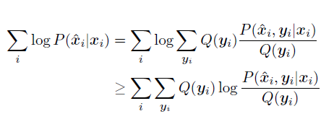
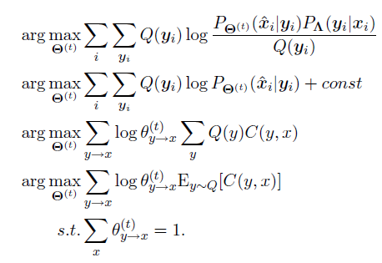
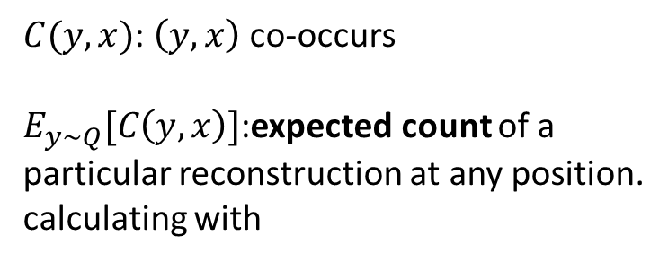
Parameter learning using EM
E-step:
M-step:
$C(y,x)$: $\left(y,x\right)$co-occurs
$E_{y\sim Q}[C\left(y,x\right)]$:expected count of a particular reconstruction at any position.
calculating with
Notes:
Q(y_{i})是第i条数据中该label序列输出的概率///Q(y)是指y在任意位置出现的概率，它是在一个针对所有数据中的输出序列y的期望值，通过marginalizing labels at all other positions in a sequence得到///C(x,y)是x和y的共现次数///E的含义是指reconstruction发生在任一位置的次数
E步是计算目标函数的下界，确定要优化什么；M步确定优化的方法就是，最大化(x,y)的共现信息。 这个共现信息是存在了一个expected count table里

Slide 18
Update Expected table Using Labeled Data
 | New | Intel | Core | I7 | Processor | Uses | an
O | 1 | 0 | 0 | 0 | 2 | 1 | 1
B-Processor | 0 | 2 | 0 | 0 | 0 | 0 | 0
I-Processor | 0 | 0 | 2 | 0 | 0 | 0 | 0
B-Memory | 0 | 0 | 0 | 2 | 0 | 0 | 0
I-Memory | 0 | 0 | 0 | 0 | 0 | 0 | 0
B-Brand | 0 | 0 | 0 | 0 | 0 | 0 | 0
Labeled data:
new Intel core i7 processor (O B-Processor I-Processor I-Processor O)
uses an Intel core i7 processor(O B-Processor I-Processor I-Processor O)
It is just a real count.
Notes:
针对全标注数据，table的更新方式就是对每个属性值对计数后再进行softmax

Slide 19
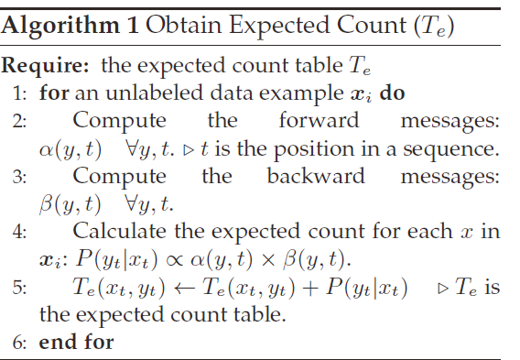
Update Expected-count table in Decoder

Slide 20
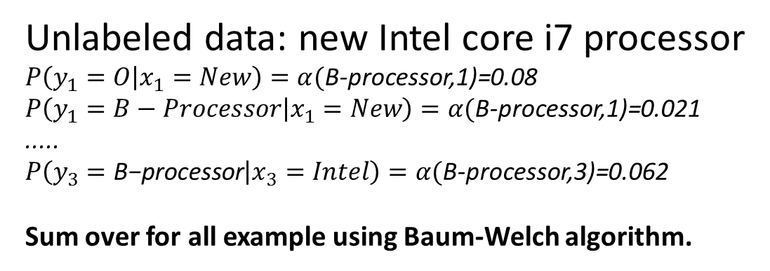
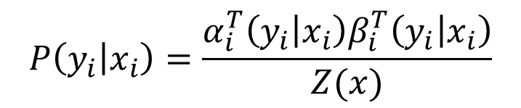
Update Expected table Using Unlabeled Data
 | New | Intel | Core | I7 | Processor | Uses | an
O | 0.08 | 0 | 0 | 0 | 0 | 0 | 0
B-Processor | 0.021 | 0.062 | 0 | 0 | 0 | 0 | 0
I-Processor | 0.017 | 0 | 0 | 0 | 0 | 0 | 0
B-Memory | 0.015 | 0 | 0 | 0 | 0 | 0 | 0
I-Memory | 0.009 | 0 | 0 | 0 | 0 | 0 | 0
B-Brand | 0.003 | 0 | 0 | 0 | 0 | 0 | 0
Unlabeled data: new Intel core i7 processor
$P\left(y_{1}=O | x_{1}=New\right)=α($B-processor,1)=0.08
$P\left(y_{1}=B−Processor | x_{1}=New\right)=α($B-processor,1)=0.021
.....
$P\left(y_{3}=\text{B}\text{−}\text{processor} | x_{3}=Intel\right)=α($B-processor,3)=0.062
Sum over for all example using Baum-Welch algorithm.
$$P\left(y_{i} | x_{i}\right)=\frac{α_{i}^{T}\left(y_{i} | x_{i}\right)β_{i}^{T}\left(y_{i} | x_{i}\right)}{Z(x)}$$
Notes:
针对无标注数据，使用前向后向计算出的lamda和theta对第i个token所在的一整列进行更新

Slide 21
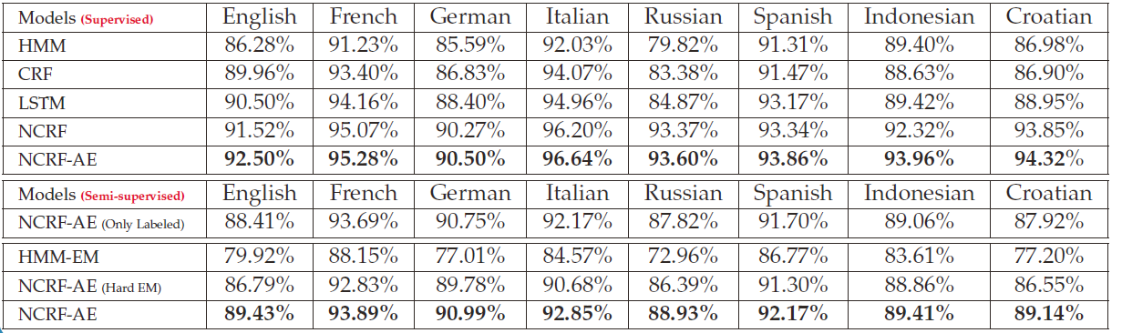
Accuracy of POS tagging on 8 UD languages
Hard EM is a self-training approach.
Only Labeled means only 20% of the labeled data is used and no unlabeled data is used.
Notes:
作者针对全监督和半监督两种模型，在八种语言的分词任务上做了测试，
作者为了验证它模型在全标注数据少的情况也能达到很好的效果，特别选择了一些low-resource的语言，比如俄语（10w），印度尼西亚（12w），克罗地亚语（14w）
NCRF就是NCRF-AE without Decoder的版本，只能用于Supervised Learning；LSTM则是只考虑x->y这条边
Semi-supervised中Label数据为20%，无label数据为50%

Slide 22
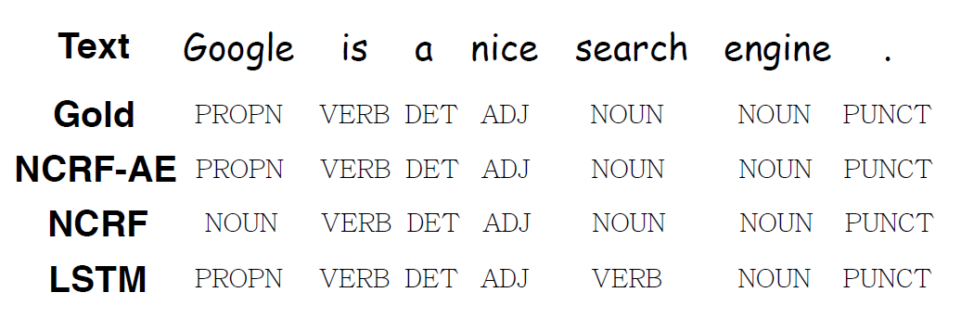
Error analysis: an example from the test set
Notes:
第一行是ground-truth，第二行是加入reconstruction decoder的NCRF,第三行是最普通的NCRF,第四行则是只考虑x->y这条边的LSTM模型
LSTM将search看成了动词，而不是名词；但是search前面的nice是正确预测成了形容词，这个错误是因为有考虑没到label之间的transition关系，形容词后面不能出现动词。
NCRF将Google这个专有名词看成了普通名词，这两种label的语法和语义是很接近的，但是再加上reconstruction这个先验知识之后，就可以正确分出来。

Slide 23
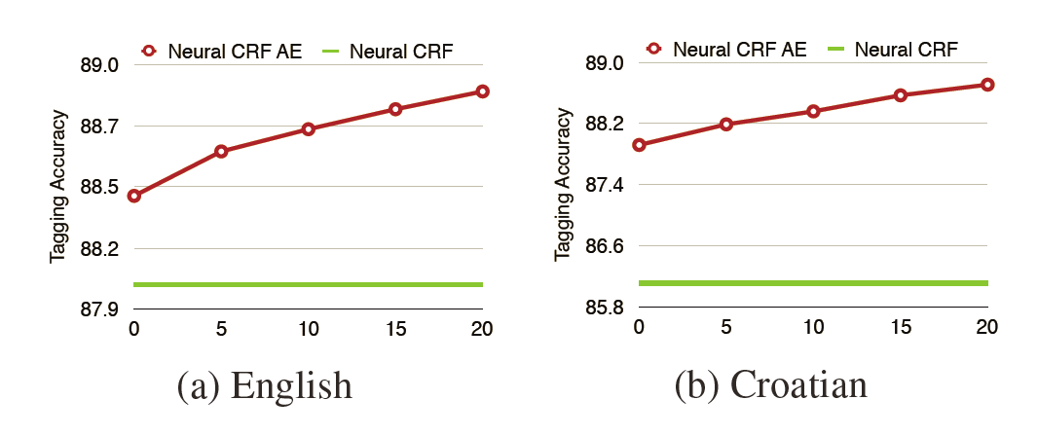
Semi-supervised learning effect
Increase proportion of unlabeled data while using 20% labeled data
Notes:
固定在20%的全标注数据下，不断提高无标注数据的数量，
量化的分析了无标注数据的带来的信息性

Slide 24
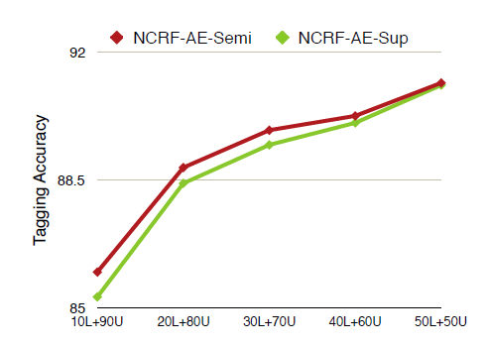
Varying sizes of labeled data on English
The difference between the red line and the green line are gradually vanishing
Notes:
在半监督学习中，希望通过少量全标注数据去提升效果。那么存在一种设想：随着全标注数据数量的提高，得到的收益会逐渐变小。
红线是同时利用了无标注数据和全标注数据，绿线只用了全标注数据了，可以看到在全标注为50%的情况下，两者的差别就基本没有了

Slide 25
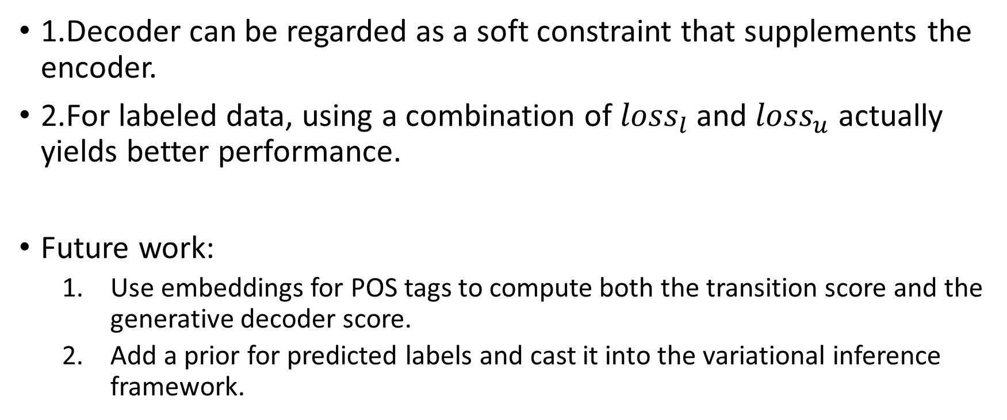
Summary
1.Decoder can be regarded as a soft constraint that supplements the encoder.
2.For labeled data, using a combination of ${loss}_{l}$and ${loss}_{u}$ actually yields better performance.
Future work:
Use embeddings for POS tags to compute both the transition score and the generative decoder score.
Add a prior for predicted labels and cast it into the variational inference framework.

Slide 26
Outline
Task Definition
Traditional CRF
Neural CRF
Semi-Supervised NCRF
My work

Slide 27
Current task
Key problem : Use semi-automatically constructed training dataset to extract the high quality template for Data2Text text generation system.
Two steps:
Derive pseudo labels.
Alignment based on the pseudo labels.
For step 2, We have two ideas to try:
Add regularization term to the existing CRF models, which is a temporary solution.
Turn to semi-supervision CRF models which treat the pseudo labels as noisy signal but not the final label.

Slide 28
Model Definition
$${\hat{x}}_{t−1}$$
$${ z}_{t−1}$$
$${ \hat{x}}_{t}$$
$${ z}_{t}$$
$${\hat{x}}_{t+1}$$
$${ z}_{t+1}$$
$$Start$$
$${ y}_{t−1}$$
$${ y}_{t}$$
$${ y}_{t+1}$$
$$End$$
$$X$$
Baseline: supervised-NCRF, only encoder
With RE S: Add Reconstruction decoder constrain, loss= Supervised
With RE SU: loss= Supervised + Unsupervised (Train Noisy Data twice)
With E: Add Noisy decoder constrain
With REE: Noisy decoder + Reconstruction decoder

Slide 29
Clean dataset from dialogue fields
Sentence number: 15888/5298/5298 (Train/dev/test)
Attribute number: 18
(Attribute/numbers/different value)
Name 21662 | 123 | Memory 140 | 7
Count 12088 | 89 | Utility 14 | 7
Price 16073 | 79 | Platform 14 | 5
Weight 1713 | 20 | Family 758 | 4
Design 20790 | 19 | Warranty 28988 | 3
Dimension 8919 | 19 | Weight range 857 | 3
Battery 1183 | 16 | Drive range 19 | 3
Processor 4618 | 10 | Price range 13 | 3
Drive 19854 | 7 | Battery rating 363 | 3
Notes:
https://github.com/shawnwun/RNNLG/tree/master/data/original/laptop

Slide 30
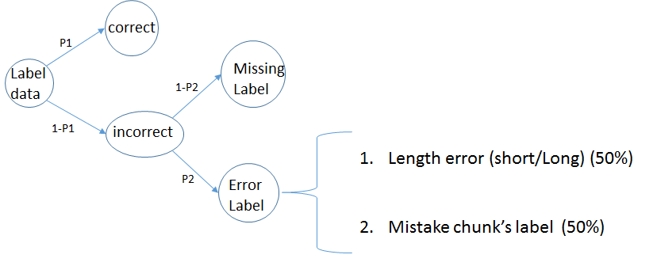
Dataset Definition
Example: p20_e30x50
Correct label chunks: 20%
Incorrect label chunks: 80%
Missing label: 80% * 70%
Mistake chunk label: 80%* 30% * 50%
Length error label: 80%* 30% * 50%
Error types | Pairs
Correct | new Intel core i7 processor (O B-Processor I-Processor I-Processor O)
Missing | new Intel core i7 processor (O O O O O)
Mistake | new Intel core i7 processor (O B-memory I-memory I-memory O)
Length error (Frequent in real task) | new Intel core i7 processor (O B-Processor I-Processor O O)

Slide 31
Parameter Definition
p20_e30x50_with_RE_SU_set_zero_nw:1.0_tw1.0
P20 e30x50: dataset quality setting
With RE SU: model setting
Set Zero: how to initialize noisy transition matrix, including top-k, semi-supervised, set zero.
NW: Noisy decoder weight in loss function
TW: Transition function weight in CRF-score function

Slide 32
Performance with p20_e30x50
Models Init Matrix (-1,1) | Precision | Recall | F1-score
Baseline | 0.9807 | 0.1923 | 0.3216
With RE S | 0.9871 | 0.2997 | 0.4598
With RE SU | 0.9816 | 0.7628 | 0.8585
With E | 0.9659 | 0.1136 | 0.2034
With REE SU | 0.9805 | 0.6801 | 0.8031
Models Init Matrix ($−\sqrt{\frac{6}{classes∗2}}$, $+\sqrt{\frac{6}{classes∗2}}$) | Precision | Recall | F1-score
Baseline | 0.9505 | 0.1824 | 0.3061
With RE S | 0.9844 | 0.2543 | 0.4042
With RE SU | 0.9786 | 0.7710 | 0.8625
With E | 0.9708 | 0.1315 | 0.2316
With REE SU | 0.9833 | 0.7469 | 0.8489

Slide 33
Performance with p40_e30x50
Models Init Matrix (-1,1) | Precision | Recall | F1-score
Baseline | 0.9936 | 0.4747 | 0.6425
With RE S | 0.9940 | 0.8037 | 0.8888
With RE SU | 0.9865 | 0.9136 | 0.9487
With E | 0.9954 | 0.5620 | 0.7184
With REE SU | 0.9853 | 0.9119 | 0.9472
Models Init Matrix ($−\sqrt{\frac{6}{classes∗2}}$, $+\sqrt{\frac{6}{classes∗2}}$) | Precision | Recall | F1-score
Baseline | 0.9939 | 0.4715 | 0.6396
With RE S | 0.9949 | 0.8455 | 0.9141
With RE SU | 0.9873 | 0.8914 | 0.9369
With E | 0.9947 | 0.5303 | 0.6918
With REE SU | 0.9896 | 0.9038 | 0.9448

Slide 34
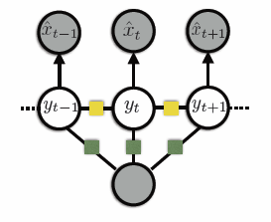
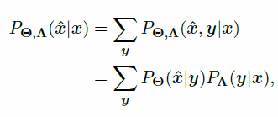






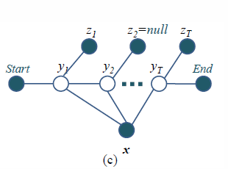

Model comparison
Objective
Inference
Data : labeled + unlabeled
17 EMNLP: structured prediction using CRF-Autoencoder
Their Q-function/likelihood in E-step are different. This is due to their goal.
The above want to maximum both encoder and decoder.
The below just to get a regularization between hidden state(true label) and observed state (derived label) .
Objective
Inference
Data : labeled + semi-labeled
09 MSR: semi-supervised CRF

